Slide 1
WELDING
MODULE 4

Slide 2
WELDING
Is defined as –
Welding is a process of making a permanent joint by establishing inter atomic bonds between two or more pieces of metal by using heat or heat and pressure.

Slide 3
Most essential requirement is heat.
Pressure may or may not be used.
Filler material may or may not be used.
Flux is used to resist oxidation and to remove impurities.
Thus, “Welding is the process of joining similar or dissimilar metals by the application of Heat, with or without the application of pressure and addition of Filler Material”.

Slide 4
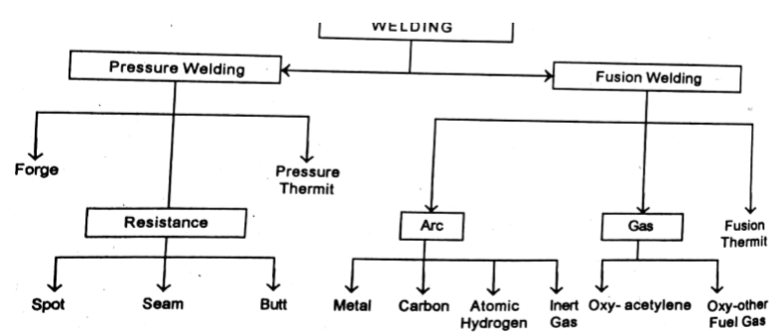
Classification Of Welding

Slide 5
Classification Of Welding
Welding of metals can be divided into two categories.
1. Plastic Welding (Pressure welding)
2. Fusion (Diffusion) Welding.
Plastic Welding -In this type of welding the metals to be joined are to be heated to the plastic state and then forced together by external pressure without the addition of filler material. Eg. Forge Welding, resistance welding.

Slide 6
Fusion Welding
In this type of welding no pressure is involved but a very high temperature is produced in or near the joint.
The metal at the joint is heated to the molten state and a joint is formed as a result of solidification.
The heat may be generated by electric arc, combustion of gases or chemical action. A filler material may be used during the welding process

Slide 7
Advantages Of Welding
It produces a permanent joint.
Overall cost of welding equipment is low.
Large number of metals can be welded.
Welding operation can be mechanized.
Welding operation is economical.
High corrosion resistance compared to bolting and riveting.

Slide 8
Disadvantages Of Welding
Welding operation distorts workpieces.
Skilled labour needed
Weld joints require heat treatment
Produces chemical and physical changes.
Gives off harmful radiations.

Slide 9
APPLICATIONS
Aircraft construction
Automobile Construction
Bridges
Buildings
Pressure vessels and tanks
Storage tanks
Rail Road Equipments
Piping and Pipelines
Ships
Machine tool
Household
Heavy machineries

Slide 10
GAS WELDING
Gas Welding is a Fusion-Welding process.
It joins metals using the heat of combustion of an oxygen/air and fuel gas. (acetylene, hydrogen, propane or butane).
Temperature produced ranges from 2600 °C to 3300 °C
The intense heat produced melts and fuses together the edges of parts to be welded, generally with the addition of Filler material.

Slide 11
Types Of Gas Welding
Oxy-Acetylene Welding
Air-Acetylene Welding
Oxy-Hydrogen Welding

Slide 12
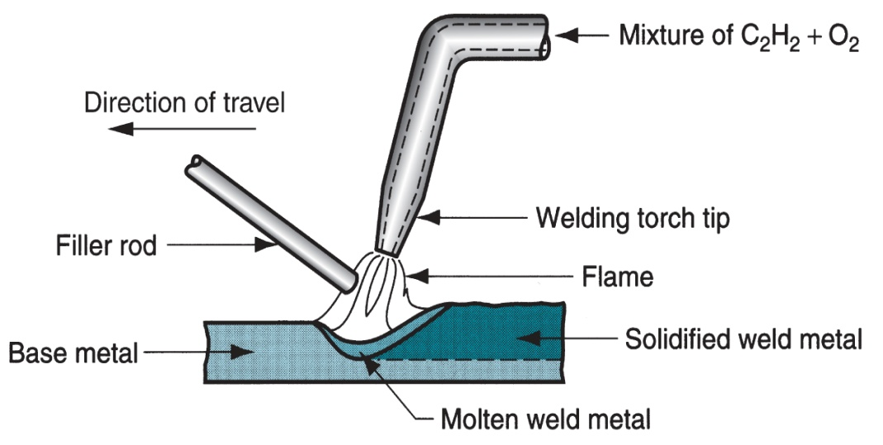
Oxy-Acetylene Welding

Slide 13
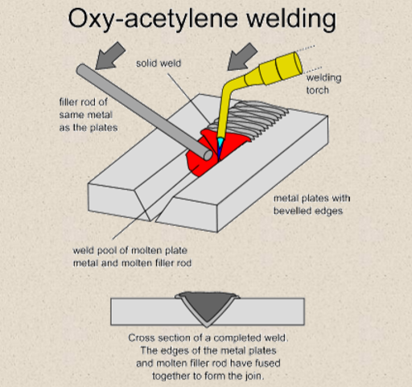

Slide 14
OXY-ACETYLENE WELDING
Principle
When Acetylene gas is mixed with oxygen in correct proportions in the welding torch and ignited, the flame resulting at the tip of the torch is sufficiently hot to melt and join the parent metal.
The oxy-acetylene flame reaches a temperature about 3200C which is sufficient to melt all commercial metals.
A pool of metals to be joined which upon solidification forms a bond.
Filler Metals are additional metal added to the weld. The composition of Filler Rod is same or nearly the same as that of the part being welded.
Filler metal (Welding Rod) added increases the strength of the bond formed.
Flux is added to remove the impurities and oxides formed during welding operation.

Slide 15
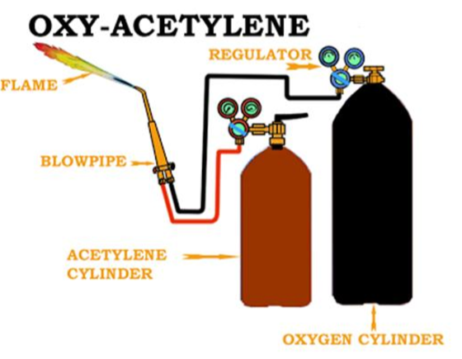
Oxy-acetylene Welding Equipment

Slide 16
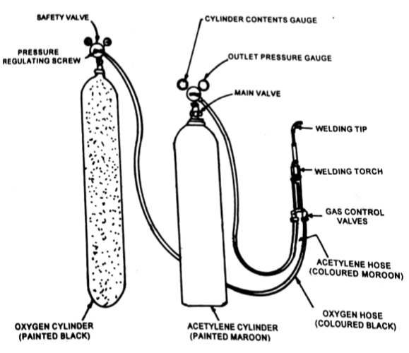
Oxy-acetylene Welding Equipment

Slide 17
Oxy-acetylene Welding Equipment
Acetylene Cylinder - Used for storing Acetylene
Oxygen Cylinder -Used for storing Oxygen
Oxygen and Acetylene pressure Regulators -The pressure of the gases obtained from the cylinders is considerably higher than the gas pressure required to carry out the welding operation.
The purpose of regulators is to
-Reduce the pressures of gases
- To produce steady flow of gases.

Slide 18
Oxy-acetylene Welding Equipment
Welding Rods - Used as Filler Metal
Flux -Used for removing impurities and oxides.
Welding Torch or Blow Pipe -Oxygen and the fuel gas are mixed in the welding torch. Welding Torch controls the flow of gases to the welding nozzle.
There are two types of Welding Torches. They are :- High Pressure (or Equal Pressure) Type : Low Pressure (or Injector) Type

Slide 19
TYPES OF FLAMES
Neutral flame.
All gas is burn
gives 100% heat.
Ideal flame used in gas welding.
Reducing flame.
It consist of inner core intermediate feather and outer flame.
It is also called as carburising flame.
strong reduction in higher zone due to high amount of acetylene .
Oxidizing flame.
It contain more oxygen than any other flame.
This is used for oxidizing metal like brass,Zink etc.
It is similar to natural flame.

Slide 20
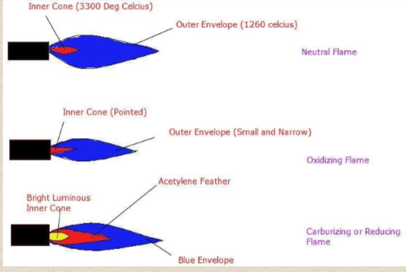

Slide 21
Advantages Of Gas Welding
Oxy-Fuel gas can be easily controlled.
Suitable for thin sheets.
Equipment is portable.
It can weld most common materials.
By changing the nozzle the torch can be use for heating, and cutting purposes.
Cost is low.

Slide 22
Disadvantages Of Gas Welding
Heavy sections cannot be joined.
Flame temperature is less than that of arc.
Refractory metals (eg. Tungsten, molybdenum, tantalum etc) and reactive metals (eg. Titanium and zirconium) cannot be gas welded.
Fluxes used produce fumes that are irritating to eyes, nose and lungs.
Slower than Arc Welding Process.
Distortion to the work piece is more compared to Arc Welding process.
Careful handling and storing is required.

Slide 23
ARC WELDING
Method of fusion welding in which the metals at the joint is heated to molten state by an electric arc
Arc column is generated between an anode(electrode) and the cathode(metal to be joined)
Temperature of the arc is about 6000⁰C to 7000⁰C
ELECTRODES
Non- consumable electrodes: carbon, graphite or tungsten(they are not consumed during welding operation)
Consumable electrodes: steel(consumed during welding operation), electrode may be bare(uncoated) or flux coated

Slide 24
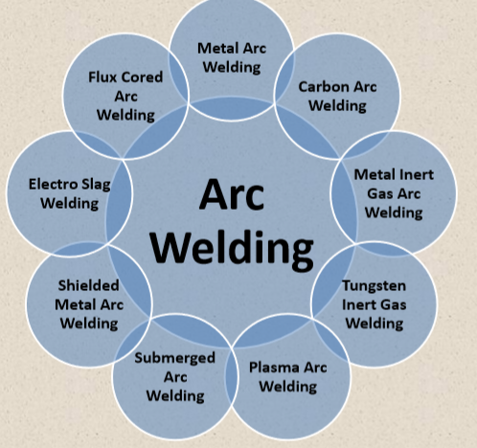

Slide 25
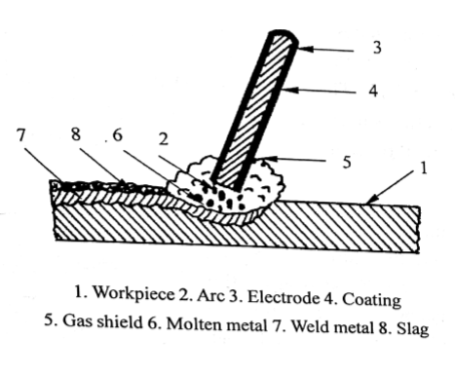
ARC WELDING

Slide 26
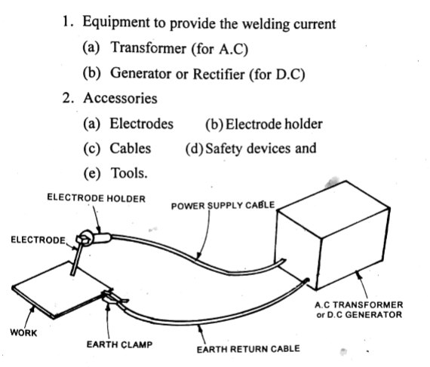
MANUAL METAL ARC WELDING EQUIPMENT

Slide 27
ARC WELDING- SHIELDED METAL ARC WELDING
The heat is generated by an electric arc between base metal and a consumable electrode.
In this process electrode movement is manually controlled hence it is termed as manual metal arc welding
In shielded metal arc welding, the protection to the weld pool is provided by covering of a) slag formed over the surface of weld pool/metal and b) inactive gases generated through thermal decomposition of flux/coating materials on the electrode

Slide 28
ARC WELDING- SHIELDED METAL ARC WELDING
This process can use both AC and DC. The constant current DC power source is invariably used with all types of electrode irrespective of base metal (ferrous and nonferrous)
AC can be unsuitable for certain types of electrodes and base materials
SHIELDED METAL ARC WELDING welding normally uses constant current type of power source with welding current 50-600A and voltage 20-80V

Slide 29
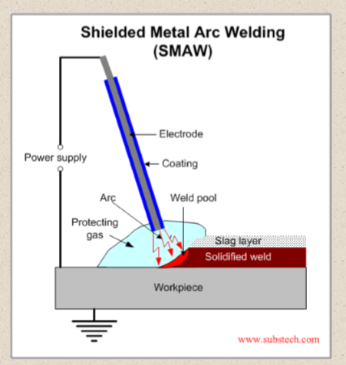

Slide 30
RESISTANCE WELDING
Parts to be joined are heated to a plastic state over a limited area by their resistance to flow of electric current(resistance heating) and then by mechanically pressing together
• Pressure is applied continuously till the weld cools down
• It is generally used for joining thin plates and structures

Slide 31
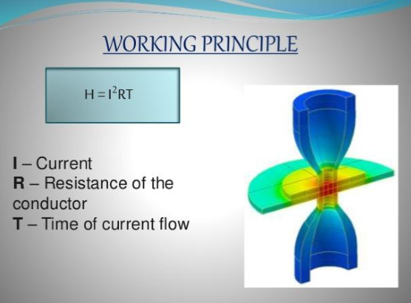

Slide 32
1.RESISTANCE SPOT WELDING
Pieces are assembled and placed between electrodes and pressure is applied
When current passes, the pieces are heated at the contact area, and due to the pressure, the contact spot gets welded

Slide 33
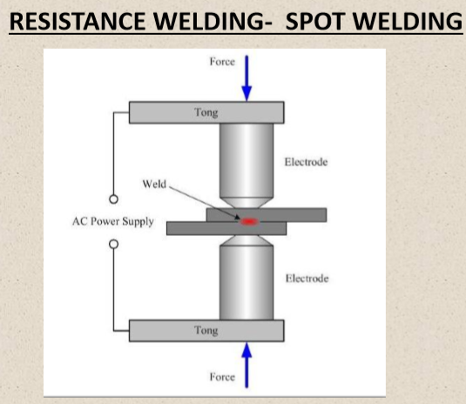

Slide 34
2.RESISTANCE SEAM WELDING
Similar to spot welding except that the electrodes are disc shaped rollers
• Electrodes roll over the sheet and a continuous weld is obtained
• Process is also called continuous spot weld process
• Timed pulses of current pass through the metal to form the overlapping welds. Welding current is usually higher than the conventional spot welding

Slide 35
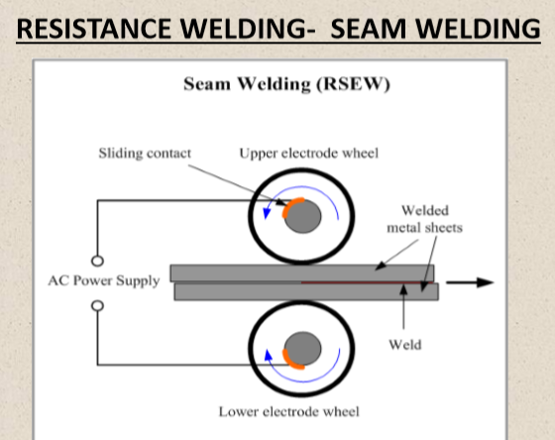

Slide 36
3.RESISTANCE BUTT WELDING
Heat obtained from the resistance to electric current through the area of contact of two surfaces
• Pressure is applied before heating is started and is maintained throughout the heating period
• Heavy current is passed from one metal piece to other. The resistance to electric current flow heats the faces to fusion temperature
• Both pressure and current are applied throughout the weld cycle

Slide 37
When the faces of the pieces become plastic, they are pressed together more firmly, upsetting the metal piece to form a dense joint
• Force is released as the welded joint has cooled to the desired temperature
• Here one Clamp is stationary and other one is movable

Slide 38
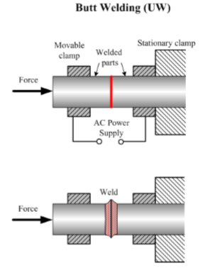

Slide 39
WELDING DEFECTS
Weld crack
Porosity
Undercut
Spatter
Slag inclusion
Poor fusion
Wraping and distortion
Lack of penetration

Slide 40
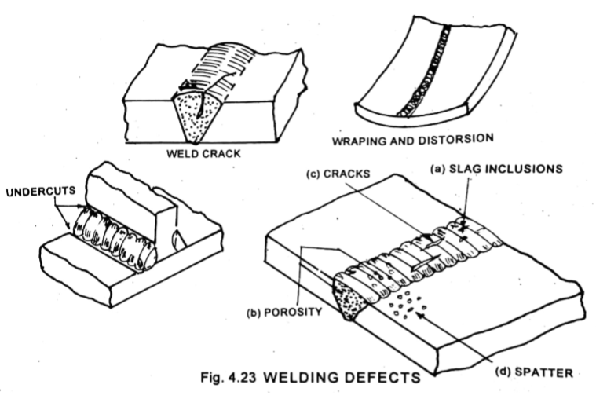
WELDING DEFECTS

Slide 41
SOLDERING
Method of joining two or more metal pieces by means of a fusible alloy or metal called solder(filler alloy), applied in molten state
The melting temperature of filler metal is lower than 450°C and also lower than the melting point of the components to be joined

Slide 42
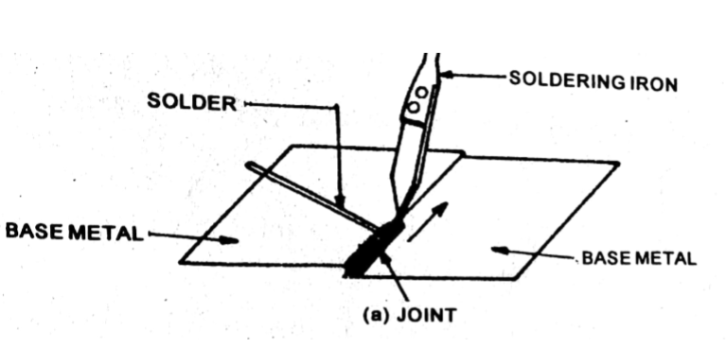
SOLDERING

Slide 43
SOLDERING
No direct melting of the metals being joined
• During the process, the filler alloy(solder) flows between the two closely adjacent surfaces of the work pieces by capillary action
• Solder is melted by using a soldering iron, which is heated by electrical resistance
• Soldering iron tips are made of copper core plated with iron. The copper is used for heat transfer and the iron plating is used for durability

Slide 44
TYPES
Soft soldering – generally used in sheet metal work for joining parts which are not subjected to high load or high temeprature. The melting point of solder using ranges from 150 to 300 °C
Hard soldering – stronger than soft soldering. Silver alloy with tin is used as hard solder , the melting point of which is 300 to 600 °C

Slide 45
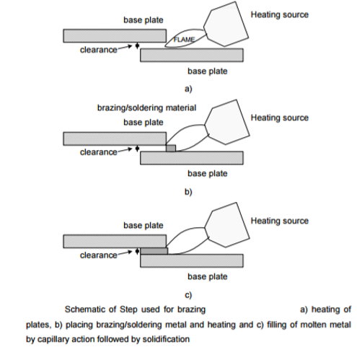

Slide 46
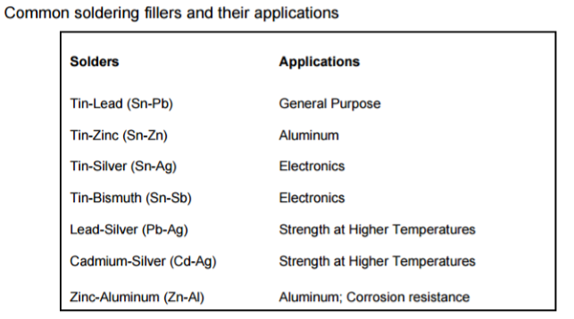

Slide 47
Applications
Joining wires in electric connections
Electronic boards and similar small parts which are not subjected to load and temperature

Slide 48
BRAZING
• Metal pieces are joined by heating the closely placed parts and then filler alloy called spelter applied in the molten state which upon solidification produces the desired joint
• Melting temperature of filler metal is more than 450°C but lower than the melting temperature of the components to be joined
No direct melting of the metals being joined
• Brazing gives a much stronger joint compared to soldering
• During the process, the filler alloy(spelter) flows between the two closely adjacent surfaces of the work pieces by capillary action
• Torch brazing is the most versatile method (Oxygen-Acetylene)

Slide 49
TYPES
TORCH BRAZING
FURNACE BRAZING
RESISTANCE BRAZING
INDUCTIVE BRAZING
INFRA RED BRAZING
APPLICATIONS - Fastening of pipe fittings, stove burners, carbide tip on tools, radiators, heat exchangers, electrical parts

Slide 50
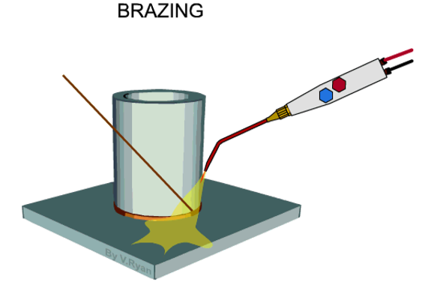

Slide 51
